Slide 1

OPERATING SYSTEMS
UE25CS242A
Introduction, Computer System Organization
Dr. Anitha K
Department of Computer Science and Engineering
Acknowledgement, Prof. Pavan A C

Slide 2
OPERATING SYSTEMS
Slides Credits for all the PPTs of this course
The slides/diagrams in this course are an adaptation, combination, and enhancement of material from the following resources:
“Operating System Concepts”, Abraham Silberschatz, Peter Baer Galvin, Greg Gagne 10th Edition, John Wiley & Sons, Global Edition, 2023.
“Advanced Programming in the Unix Environment”, Richard Stevens and Stephen A Rago, Pearson, 3rd edition, 2017.
Some conceptual text and diagram from “Operating Systems, Internals and Design Principles”, William Stallings, 9th Edition, Pearson, 2018.

Slide 3
OPERATING SYSTEMS
Introduction, Computer System Organization
Dr. Anitha K
Department of Computer Science and Engineering
Notes:
I am going to introduce Operating System, what they are, what they do and why it’s important.
OS runs on computers, mobiles, gadget and many other devices.
Thorough OS knowledge is required to work on System Software including Compilers and Device Drivers.
Real Time OS is used in embedded systems, TVs, Car/Game Consoles.
Multiple Operating Systems: UNIX, Linux, Windows, Mac OS, Android, Solaris, HP-UX, IBM AIX, BSD

Slide 4
Course Objectives:
Focus on fundamental Operating System concepts.
Provide an understanding of various components of the Operating System (OS).
Delve deeper into various algorithms and associated trade-offs for efficient resource management such as process, disk, and memory management.
Introduce design principles and trade-offs in the design of Operating Systems.

Slide 5
Course Outline
Unit 1 : Introduction and Process Management – 14 hours
What Operating Systems Do, Computer-System Organization, Computer-System Architecture, Operating System Structure & Operations, Operating-System Services; Process Concept: Process in Memory, Process State, Process Control Block (PCB), Process Creation and Termination, System Calls for Process Management, Life Cycle of I/O Requests. CPU Scheduling: Basic Concepts, Scheduling Criteria, Scheduling Algorithms: First-Come First-Served (FCFS), Shortest-Job-First (SJF), Priority Scheduling, Round-Robin Scheduling, Multilevel Queue Scheduling, Multilevel Feedback Queue Scheduling; Introduction to Shell Programming: Variables, Control Flow, Shell Scripts, Scheduler – cron.
Unit 2 : IPC, Threads and Concurrency – 14 hours
IPC: Shared Memory, Message Passing, Pipes – Named and Ordinary, System Calls for Shared Memory, Pipes and FIFOs, Linux Domain Sockets; Introduction to Threads: Types of Threads, Multicore Programming, Multithreading Models, Thread Control Block (TCB), Thread Creation, Thread Scheduling, Thread Libraries, POSIX Threads (Pthreads); Multicore Kernel Concepts: Symmetric Multiprocessing (SMP), Kernel Parallelism, CPU Affinity, Load Balancing, Multicore Scheduling; Mutual Exclusion and Synchronization: Software Approaches, Principles of Concurrency, Hardware Support, Mutex Locks, Semaphores; Scalable Synchronization: Spinlocks, Reader-Writer Locks, Lock Contention; Classic Synchronization Problems; Deadlocks: Principles of Deadlock, Deadlock Characterization, Deadlock Avoidance; Signals and Signal Handling.

Slide 6
Course Outline
Unit 3: Memory Management – 14 hours
Main Memory: Hardware and Control Structures, OS Support, Address Translation, Dynamic Loading, Dynamic Linking and Shared Libraries, Memory-Mapped Files and mmap(), Swapping, Fragmentation, Segmentation, Paging, Structure of Page Tables, Translation Lookaside Buffer (TLB), TLB Hits and Misses, Effective Access Time (EAT); Virtual Memory: Demand Paging, Page-Fault Handling, Copy-on-Write, Page Replacement, Allocation of Frames, Thrashing, NUMA (Non-Uniform Memory Access) Basics and Memory Locality, Clock Page Replacement.
Unit 4 : File Management, Storage Management and Security – 14 hours
File Concept: Access Methods, Directory, Driver Development, Flash Drives, File-System sharing, File system protection, System calls to retrieve file attributes, file types, file operations, reading directories, File system implementation, Directory implementation, allocation methods, Free-Space Management, Efficiency and Performance, Mass storage structure, Disk Structure, Disk scheduling, Disk Management, RAID Structure, OS Security, Access Matrix, Implementation of the Access Matrix, Access Control, Revocation of Access Rights; Shell programming – awk, sed.

Slide 7
Course Outcomes
At the end of this course, the student will be able to:
Understand the principles and modules of Operating Systems.
Understand the design of various algorithms for scheduling and their relative performance.
Understand the concept of Deadlocks that typically occur in OS. Deadlocks - Avoidance and Detection.
Implement Operating Systems Concepts related to process management, Concurrent processes, Threads and Memory Management.

Slide 8
Textbooks
Text Book(s):
“Operating System Concepts”, Abraham Silberschatz, Peter Baer Galvin, Greg Gagne 10th Edition, John Wiley & Sons, Global Edition, 2023.
“Advanced Programming in the Unix Environment”, Richard Stevens and Stephen A Rago, Pearson, 3rd edition, 2017.
Reference Book(s):
“Operating Systems, Internals and Design Principles”, William Stallings, 9th Edition, Pearson, 2018.
“Modern Operating Systems”, Andrew S Tanenbaum, 3rd edition, Pearson, 2007.
“Learning the bash shell”, Cameron Newham, 3rd edition, O’Reilly, 2005

Slide 9
Course Evaluation Policy
OPERATING SYSTEMS
Components | Conduction Marks | Scaled Marks
Internal Semester Assessment (ISA)-1 | 40 | 15
Internal Semester Assessment (ISA)-2 | 40 | 15
Experiential Learning / Continuous Assessment | 70 | 20
ESA | 100 | 50
Total | 250 | 100
Experiential Learning components | Conduction Marks | Scaled Marks
Level1 Problem-1 | 10 | 2
Level1 Problem-2 | 10 | 2
Level2 Problem | 25 | 6
Level3 Problem | 25 | 10
Total | 70 | 20

Slide 10
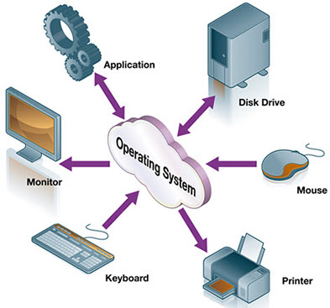
OPERATING SYSTEMS
Need for Operating System
If OS is not developed then how will the application developers access the hardware?

Slide 11
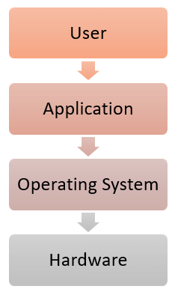
OPERATING SYSTEMS
General Definition
An Operating System is a program that acts as an intermediary between a user of a computer and the computer hardware
It provides a user-friendly environment in which a user may easily develop and execute programs. Otherwise, hardware knowledge would be mandatory for computer programming.

Slide 12
OPERATING SYSTEMS
Operating System Goals
Execute user programs and make solving user problems easier
Make the computer system convenient to use
Use the computer hardware in an efficient manner
Manage resources such as
• Memory
• Processor(s)
• I/O Devices
Notes:
OS manages hardware, allocates resources, controls program execution and provides user program environment

Slide 13
OPERATING SYSTEMS
Why Study Operating Systems?
Only a small percentage of computer practitioners will be involved in the creation or modification of an operating system.
However almost all code runs on top of an operating system, and thus knowledge of how operating systems work is crucial to proper, efficient, effective, and secure programming.
Understanding the fundamentals of operating systems
Notes:
OS manages hardware, allocates resources, controls program execution and provides user program environment

Slide 14

OPERATING SYSTEMS
Four Components of a Computer System (Abstract view)
© copyright Silberschatz, Galvin and Gagne, 2013

Slide 15
OPERATING SYSTEMS
Computer System Structure
Hardware – provides basic computing resources
CPU, memory, I/O devices
Operating system
Controls and coordinates use of hardware among various applications and users
Application programs – define the ways in which the system resources are used to solve the computing problems of the users
Word processors, compilers, web browsers, database systems, video games
Users
People, machines, other computers
Notes:
Computer system can be divided into four components: Hardware, OS, Application Programs and Users

Slide 16
OPERATING SYSTEMS
What Operating Systems Do
Depends on the point of view user and system
Users want convenience, ease of use and good performance
Don’t care about resource utilization
But shared computer such as mainframe or minicomputer must keep all users happy.
Maximize resource utilization.
Available CPU time, memory, and I/O are used efficiently and that no individual user takes more than her fair share
Notes:
Three conceptual pieces that are fundamental to operating systems: Virtualization (CPU scheduling, Process management, Memory management – Paging & Segmentation), Concurrency (like Threads, locks, condition variables & Semaphores), and Persistence (I/O devices, file systems, storage, data integrity/protection, Distributed Systems, NFS).

Slide 17
OPERATING SYSTEMS
What Operating Systems Do
Users of dedicated systems such as workstations have dedicated resources but frequently use shared resources from servers.
resources like file, compute, and print servers are shared.
operating system is designed to compromise between individual usability and resource utilization
Handheld computers are resource poor, optimized for usability and battery life.
Some computers have little or no user interface, such as embedded computers in devices and automobiles
Notes:
Three conceptual pieces that are fundamental to operating systems: Virtualization (CPU scheduling, Process management, Memory management – Paging & Segmentation), Concurrency (like Threads, locks, condition variables & Semaphores), and Persistence (I/O devices, file systems, storage, data integrity/protection, Distributed Systems, NFS).

Slide 18
OPERATING SYSTEMS
System View
OS is a resource allocator
Manages all resources
Decides between conflicting requests for efficient and fair resource use
OS is a control program
Controls execution of programs to prevent errors and improper use of the computer
Notes:
At Computer Startup, bootstrap program (or loader) is loaded at power-up or reboot
Typically stored in ROM or EPROM, generally known as firmware
Initializes all aspects of system
Loads operating system kernel and starts execution

Slide 19
OPERATING SYSTEMS
Defining Operating System
The OS has many roles and functions
The fundamental goal of computer systems is to execute user programs and to make solving user problems easier.
The common functions of controlling and allocating resources are then brought together into one piece of software: the operating system
“The one program running at all times on the computer” is the kernel.
Everything else is either
a system program (ships with the operating system) , or
an application program.
Notes:
At Computer Startup, bootstrap program (or loader) is loaded at power-up or reboot
Typically stored in ROM or EPROM, generally known as firmware
Initializes all aspects of system
Loads operating system kernel and starts execution

Slide 20
OPERATING SYSTEMS
Computer System Organization
Computer-system consists of,
One or more CPUs, device controllers connect through common bus providing access to shared memory
The CPU and the device controllers can execute concurrently, competing for memory cycles.
memory controller is provided to synchronize access to the memory.
© copyright Silberschatz, Galvin and Gagne, 2013

Slide 21
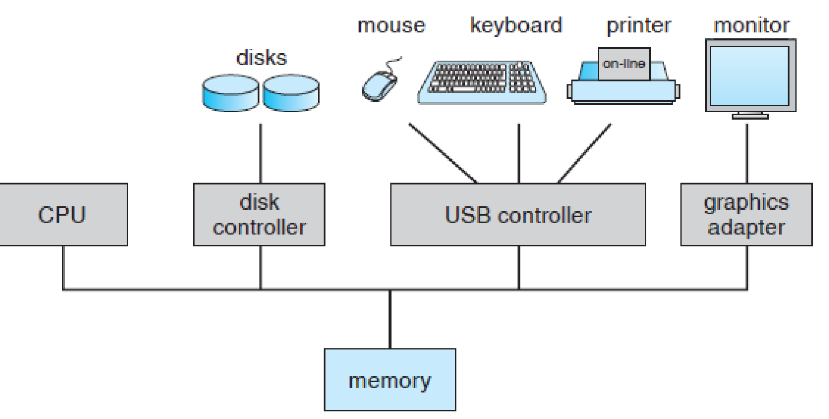
OPERATING SYSTEMS
Computer System Organization
A modern computer system
© copyright Silberschatz, Galvin and Gagne, 2013

Slide 22
OPERATING SYSTEMS
Computer System Operation
I/O devices and the CPU can execute concurrently
Each device controller is in charge of a particular device type
Each device controller has a local buffer
Each device controller has registers for action (like “read character from keyboard”) to take
CPU moves data from/to main memory to/from local buffers
I/O is from the device to local buffer of controller
Device controller informs CPU that it has finished its operation by causing an interrupt

Slide 23
OPERATING SYSTEMS
Computer System Organization
When the system is booted, the first program that starts running is a Boostrap.
It is stored in read-only memory (ROM) or electrically erasable programmable read-only memory (EEPROM).
Bootstrap is known by the general term firmware, within the computer hardware.
It initializes all aspects of the system, from CPU registers to device controllers to memory contents.
The bootstrap program must know how to load the operating system and how to start executing that system.
The bootstrap program must locate and load into memory the operating system kernel.
The first program that is created is init, after the OS is booted. It waits for the occurrence of event.
© copyright Silberschatz, Galvin and Gagne, 2013

Slide 24
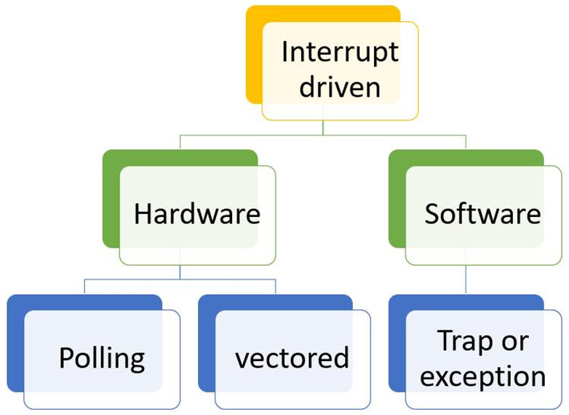
OPERATING SYSTEMS
Common Functions of Interrupts
An operating system is interrupt driven
Interrupt transfers control to the interrupt service routine generally, through the interrupt vector, which contains the addresses of all the service routines
Interrupt architecture must save the address of the interrupted instruction
A trap or exception is a software-generated interrupt caused either by an error or a user request

Slide 25
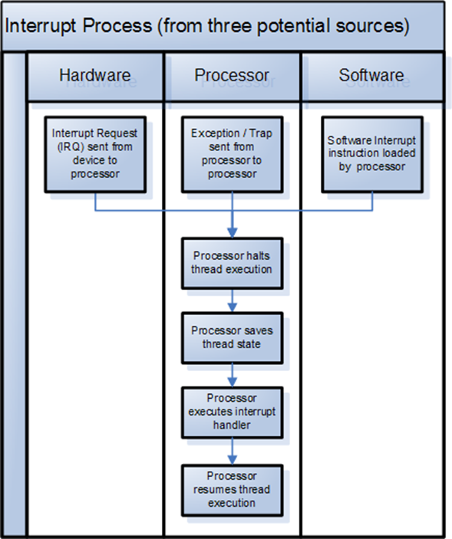
OPERATING SYSTEMS
Interrupt Handling
The operating system saves the state of the CPU by storing registers and the program counter
Determines which type of interrupt has occurred:
polling
vectored interrupt system
Separate segments of code determine what action should be taken for each type of interrupt
Notes:
In a computer, a polled interrupt is a specific type of I/O interrupt that notifies the part of the computer containing the I/O interface that a device is ready to be read or otherwise handled but does not indicate which device. The interrupt controller must poll (send a signal out to) each device to determine which one made the request. Polled interrupt is an inefficient method of data transfer, spending much time checking the ready condition of a computer's devices.
The alternative to a polled interrupt is a vectored interrupt , an interrupt signal that includes the identity of the device sending the interrupt signal.

Slide 26
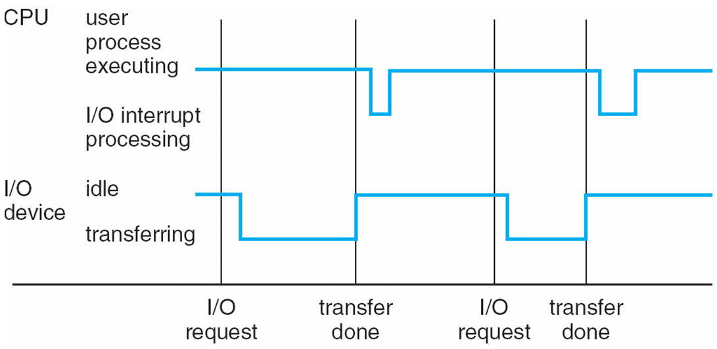
OPERATING SYSTEMS
Interrupt Timeline for a single process doing output
Interrupt processing times vary..
..and so do I/O transfer times

Slide 27
OPERATING SYSTEMS
Storage Structure
Main memory – only large storage media that the CPU can access directly (Random access memory and typically volatile)
Implemented with semiconductor technology called DRAM
Computers use other forms of memory like ROM, EEPROM
Smart phones have EEPROM to store factory installed programs.

Slide 28
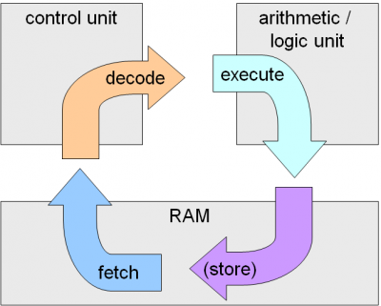
OPERATING SYSTEMS
Program Execution Model
Typical instruction execution
The processor fetches instructions from memory, decodes and executes them.
The Fetch, Decode and Execute cycles are repeated until the program terminates.
This is called the Von Neumann model of computing.
Image source :https://computersciencewiki.org/index.php/The_machine_instruction_cycle

Slide 29
OPERATING SYSTEMS
Storage Structure
Secondary storage – extension of main memory that provides large nonvolatile storage capacity
Hard disks – rigid metal or glass platters covered with magnetic recording material
Disk surface is logically divided into tracks, which are subdivided into sectors
The disk controller determines the logical interaction between the device and the computer
Solid-state disks – faster than hard disks, nonvolatile
Various technologies and becoming more popular
Flash memory used in camera’s PDA’s

Slide 30
OPERATING SYSTEMS
Storage Hierarchy
Storage systems organized in hierarchy
Speed
Cost
Volatility
Caching – copying information into faster storage system; main memory can be viewed as a cache for secondary storage

Slide 31
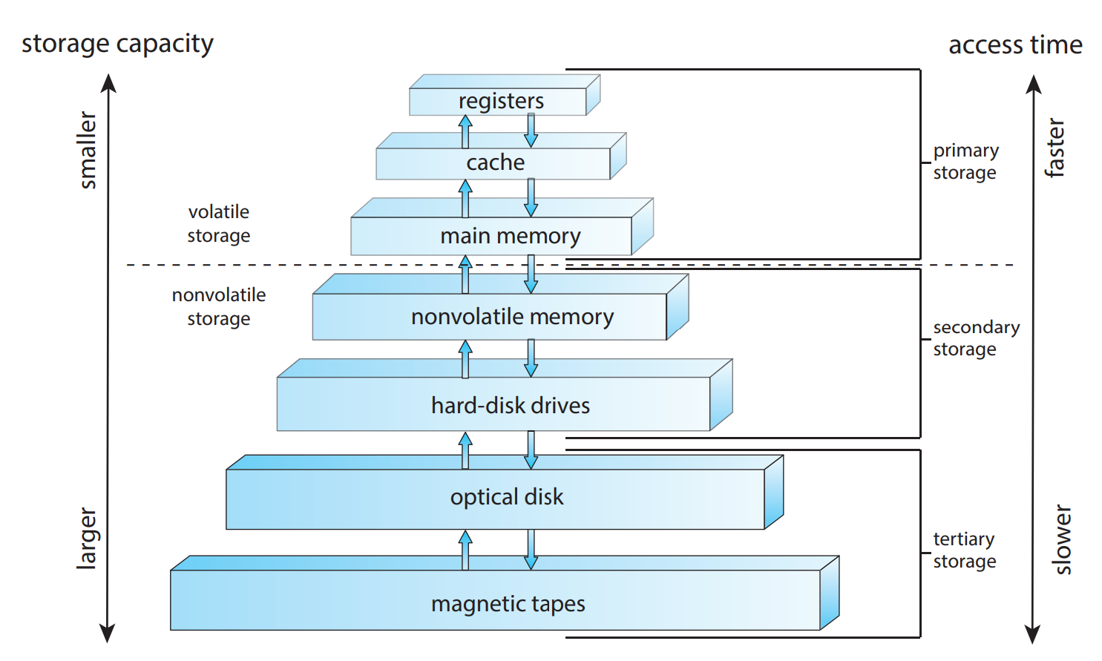
OPERATING SYSTEMS
Storage-Device Hierarchy

Slide 32
OPERATING SYSTEMS
Caching
Important principle, performed at many levels in a computer (in hardware, operating system, software)
Information in use copied from slower to faster storage temporarily
Faster storage (cache) checked first to determine if information is there
If it is, information used directly from the cache (fast)
If not, data copied to cache and used there
Cache smaller than storage being cached
Cache management important design problem
Cache size and replacement policy

Slide 33
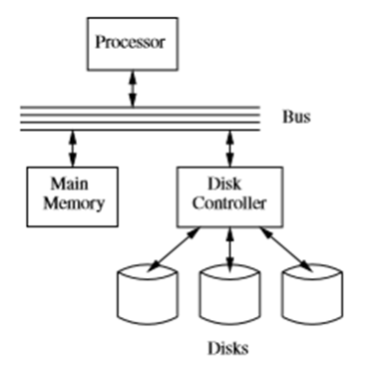
OPERATING SYSTEMS
I/O Structure
Storage is a type of I/O device
A large portion of operating-system code is dedicated to managing I/O
As reliability and performance of a system is the main concern.
General-purpose computer system consists of CPUs and multiple device controllers that are connected through a common bus.
Each device controller is in charge of a specific type of device.
Device Driver for each device controller to manage I/O
Provides uniform interface between controller and kernel
Small Computer-Systems Interface (SCSI) controller enables to connect more devices.

Slide 34
OPERATING SYSTEMS
I/O Structure
A device controller maintains some local buffer storage and a set of special-purpose registers.
The device controller is responsible for moving the data between the peripheral devices.

Slide 35
OPERATING SYSTEMS
I/O Structure
After I/O starts, control returns to user program only upon I/O completion
Wait instruction idles the CPU until the next interrupt
Wait loop (contention for memory access)
At most one I/O request is outstanding at a time, no simultaneous I/O processing
After I/O starts, control returns to user program without waiting for I/O completion
System call – request to the OS to allow user to wait for I/O completion
Device-status table contains entry for each I/O device indicating its type, address, and state
OS indexes into I/O device table to determine device status and to modify table entry to include interrupt.

Slide 36
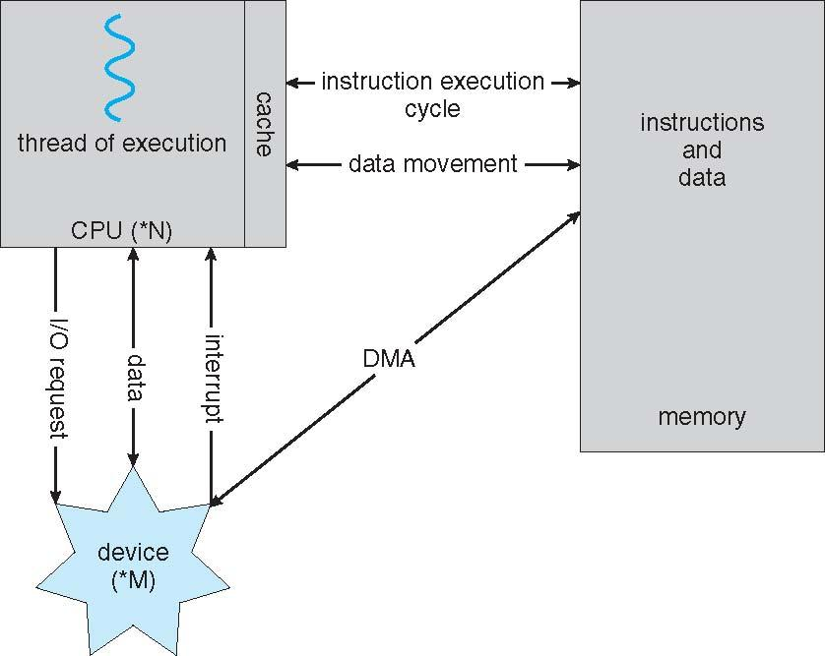
OPERATING SYSTEMS
Direct Memory Access Structure
Used for high-speed I/O devices able to transmit information at close to memory speeds
Device controller transfers blocks of data from buffer storage directly to main memory without CPU intervention
Only one interrupt is generated per block, rather than the one interrupt per byte

Slide 37
THANK YOU
Dr. Anitha K
Department of Computer Science and Engineering
anithak@pes.edu

